Slide 1
Day 2 Agenda
DAY
7
Advanced Setup – Design Transforms
2
8
Debug
9
Advanced Usage

Slide 2
Unit Objectives
After completing this unit, you should be able to:
Apply the recommended debugging procedure to a failing verification
List the failing points
Run Error Diagnosis to isolate setup errors or errors in implementation
Use Pattern Window and Logic Cone Display to investigate failures that are not isolated by Error Diagnosis.
2

Slide 3
Formality Flow Overview (review)
Start
0: Guidance
Specify Automated Setup File
3: Setup
1: Read Reference Design + Libs
4: Match
6: Debug
set_top
5: Verify
Success?
2: Read Implementation Design + Libs
N
Y
set_top
End
3

Slide 4
Debugging Flow Chart
Start
3: Setup
display failing points
resolve black boxes
run diagnosis
change setup
Problem identified?
Fix design
unmatched points?
Design Error?
N
Y
choose point to debug
Check for failing SVF operations
display pattern window
change setup
display logic cone
isolate difference
4: Match
4

Slide 5
Resolving Black Boxes
Use report_black_box command
fm_shell (setup)> report_black_box
5

Slide 6
Unmatched points - example
fm_shell (verify)> verify
Reference design is 'r:/WORK/chip'
Implementation design is 'i:/WORK/chip'
******************************* Matching Results *******************************
258 Compare points matched previously
0 Compare points matched by name
0 Compare points matched by signature analysis
0 Compare points matched by topology
128(128) Unmatched reference(implementation) compare points
0(0) Unmatched reference(implementation) primary inputs, black box outputs
--------------------------------------------------------------------------------
Unmatched Objects REF IMPL
--------------------------------------------------------------------------------
Registers 128 128
DFF 128 128
********************************************************************************
***************************** Verification Results *****************************
Verification FAILED
-------------------
Reference design: r:/WORK/chip
Implementation design: i:/WORK/chip
130 Passing compare points
20 Failing compare points
108 Aborted compare points
--------------------------------------------------------------------------------
Matched Compare Points BBPin Loop Net BlPin Port DFF LAT TOTAL
--------------------------------------------------------------------------------
Passing (equivalent) 2 0 0 0 128 0 0 130
Failing (not equivalent) 0 0 0 0 0 20 0 20
Aborted
Unver (^C/limit hit) 0 0 0 0 0 108 0 108
********************************************************************************
6

Slide 7
Unmatched Points – Clues to Identify Causes
Symptom
Possible Cause
Action
More unmatched points in ref than in imp
FM is ignoring full case
- change hdlin_ignore_full_case to false
DC removed constant registers
check for failed SVF operations
adjust FM reg init settings
Black box in ref
- read missing cells into ref
- make black box in imp
Re-encoded FSM
check for failed SVF operations
apply FSM reencoding manually
More unmatched points in imp than in ref
Design transformation created extra logic
check for failed SVF operations
set verification_clock_gate_hold_mode
Black box in ref
- read missing cells into imp
- make black box in ref
Re-encoded FSM
check for failed SVF operations
apply FSM reencoding manually
Insertion of test
disable test with set_constant
Same number of unmatched points in ref and imp
Names have undergone a transformation
- check for failed SVF operations
- set user match
- write compare rule
- modify name_match* variables
7

Slide 8
Unmatched Points – The 5 Main Causes
Failing SVF operations
  guide_reg_constant
  guide_fsm_reencoding
  guide_change_names
  guide_uniquify, guide_ununiquify
Inconsistent black-boxes in ref and impl
Simulation/synthesis differences
  Remember to check if full_case or parallel_case pragmas are used
Missing setup
Constant register removal or name change not recorded in SVF
  Report to Synopsys if you encounter this
8

Slide 9
Displaying Unmatched Points
To display list of unmatched points in the shell:
See Section 4 for guidance on investigating / fixing
Remember! Unmatched points are sometimes OK but you should review them to make sure before continuing
fm_shell (verify)> report_unmatched
9

Slide 10
Display Failing Points
Once the unmatched points have been accounted for, you can start debugging the failing points:
  Use report_failing_points to get a list of the failing points
10

Slide 11
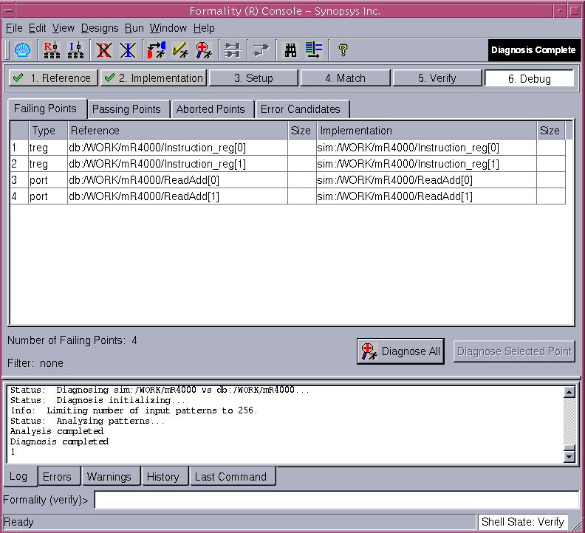
Display Failing Points - GUI
  Display Information from the GUI:
11

Slide 12
Diagnosis
Run diagnosis
  Creates a set of failing test vectors
  Performs an analysis of the failing vectors to help pinpoint the cells in the logic cones that are causing the failure
12

Slide 13
Error Diagnosis Vocabulary
Error – Location of error in implementation design
Error Candidates – Set of Errors / Alternates
Examples
Single error detected in implementation design.
Number of error candidates: 2
2 distinct errors detected in implementation design.
Number of error candidates: 3
Matching regions in the reference design
  areas in the reference design that corresponded to the diagnosed error in the implementation.
13

Slide 14
How does it work?
The algorithm works by analyzing intersecting path traces for all failing compare points.
If all the path traces intersect with each other, it may indicate the presence of a single error.
If no single error is identified, the algorithm enters an iterative stage of multiple error diagnosis.
If there are too many errors ( >5 ), the algorithm fails to report any error candidates. In such cases, the user can do a directed diagnosis by specifying a subset list of failing points.
14

Slide 15

Path Trace Procedure : example
0
1
0
1
1
0
1
1
1
0
1
1
0
1
0
A
B
C
D
E
A
B
C
D
E
A
B
C
D
E
A
B
C
D
E
X2
X2
X2
X2
X1
X1
X1
X1
0
1
1
0
0
1
X3
X4
X3
X4
X3
X4
X3
X4
0
0
1
0
1
0
X5
X6
X5
X6
X5
X6
X5
X6
O1
O2
O1
O2
O1
O2
O1
O2
0
0
0
0
0
0
Notes:
Here is a small example of how the path tracing works. The circuit on the left is the reference, and there are three copies of the implementation on the right. In the implementation, the OR gate X4 is replaced by a NOR gate.
Each implementation has a different failing pattern applied to it. At the top you see the pattern. For each pattern, one of the outputs of the implementation differ from the similar output in the reference; these are indicated by the red color. It may be that multiple outputs fail with the same pattern; these three examples only have a single output failure for each pattern.
Starting at each failing output, a path is traced back through the gates leading up to that output. At each gate, the controlling inputs of that gate are followed. In the case of an AND gate (for example), if the output of the AND is 0, that means one (or more) of the inputs must be 0; this input is considered the controlling input, and that is the input that is traced backwards. If the output of the AND is 1, all inputs must be 1, and each is considered to be a controlling input. X6 in implementation 1, and X1 in implementation 2, show this behavior. Controlling inputs for OR gates follow a similar pattern. For XOR gates, both inputs are considered controlling, since in any situation, each input directly controls the output.
In the first example, the path obtained includes { C, D, X2, X4, X6, and O2 }. By analyzing this path with the paths obtained from the other two failing patterns, you can see that the common subset of ports/gates is { C and X4 }. (note to self: I think C is eliminated by the next error simulation step, and I need to verify this with an actual run; I can’t determine how to fix the circuit just by adjusting C).
C is eliminated by the next error simulation step, you can verify this with an actual run. X4 gets reported as the candidate to fix to correct the implementation.

Slide 16
Path Trace Procedure : example
0
1
0
1
1
0
1
1
1
0
1
1
0
1
0
A
B
C
D
E
A
B
C
D
E
A
B
C
D
E
A
B
C
D
E
X2
X1
X3
X4
X4
X4
X4
X5
X6
O1
O2
O1
O2
O1
O2
O1
O2
Notes:
Just a little highlighting to show the common elements of all failing paths.

Slide 17
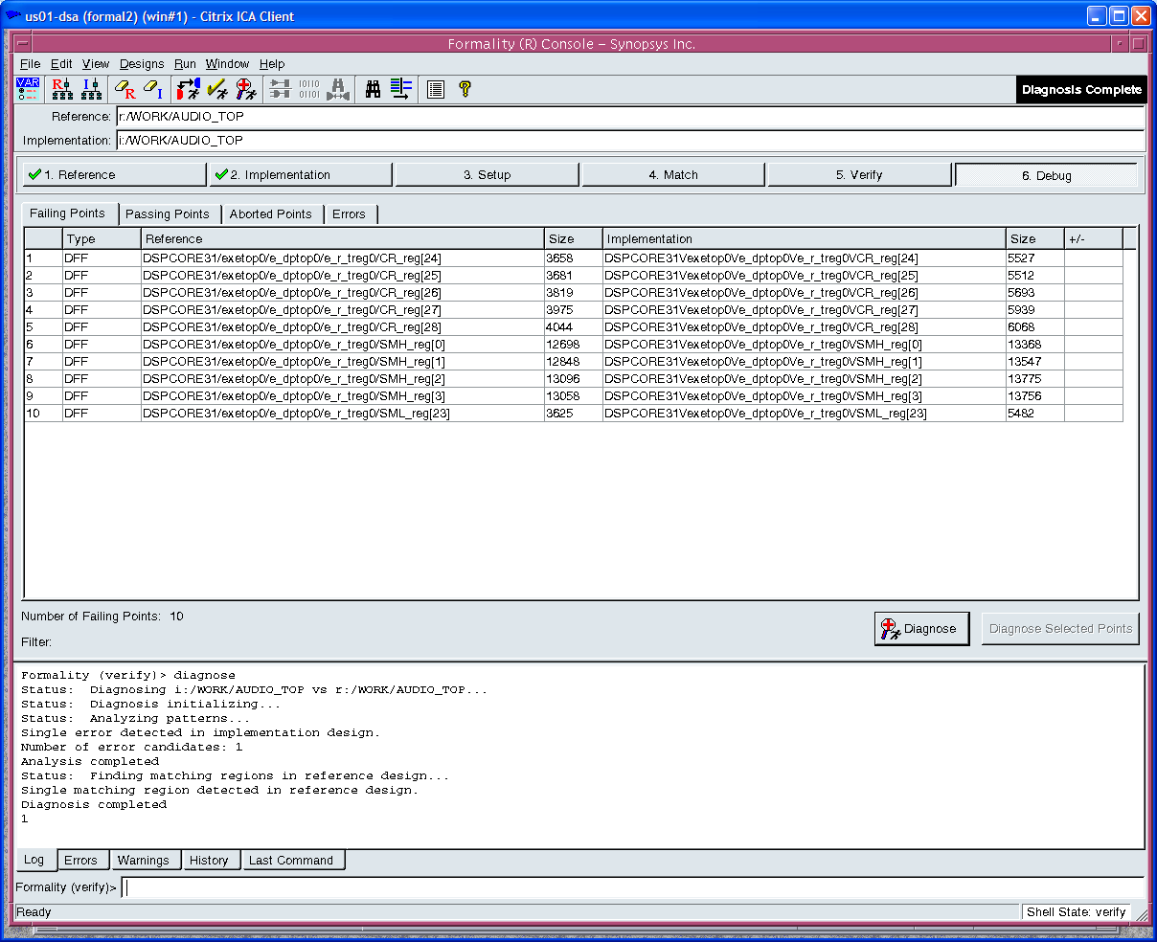
Example: Start with a failing verification and click diagnose button
17

Slide 18
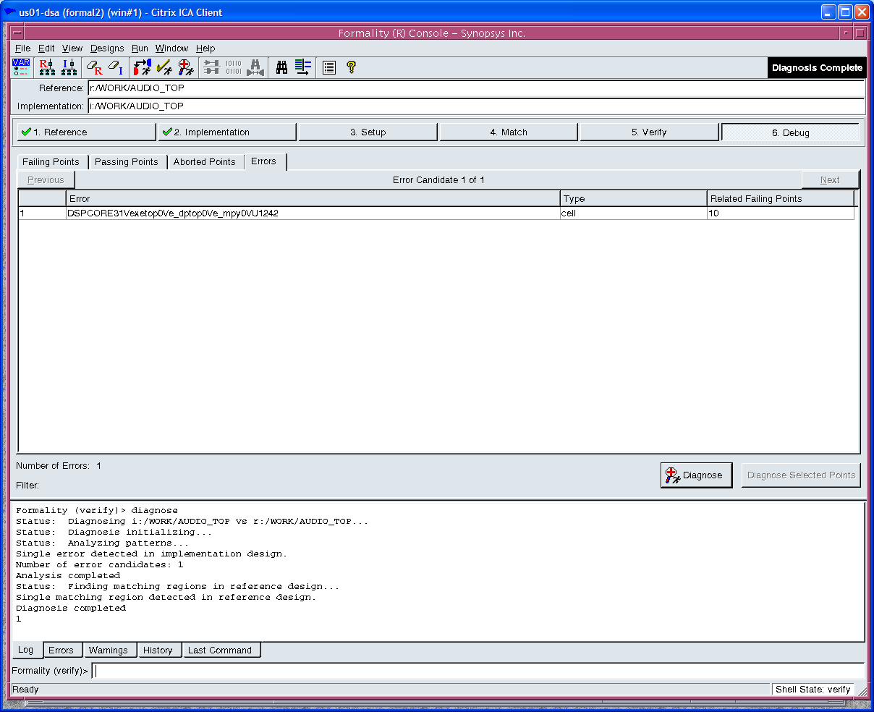
Diagnosed Error Window: After diagnosis completes
18

Slide 19
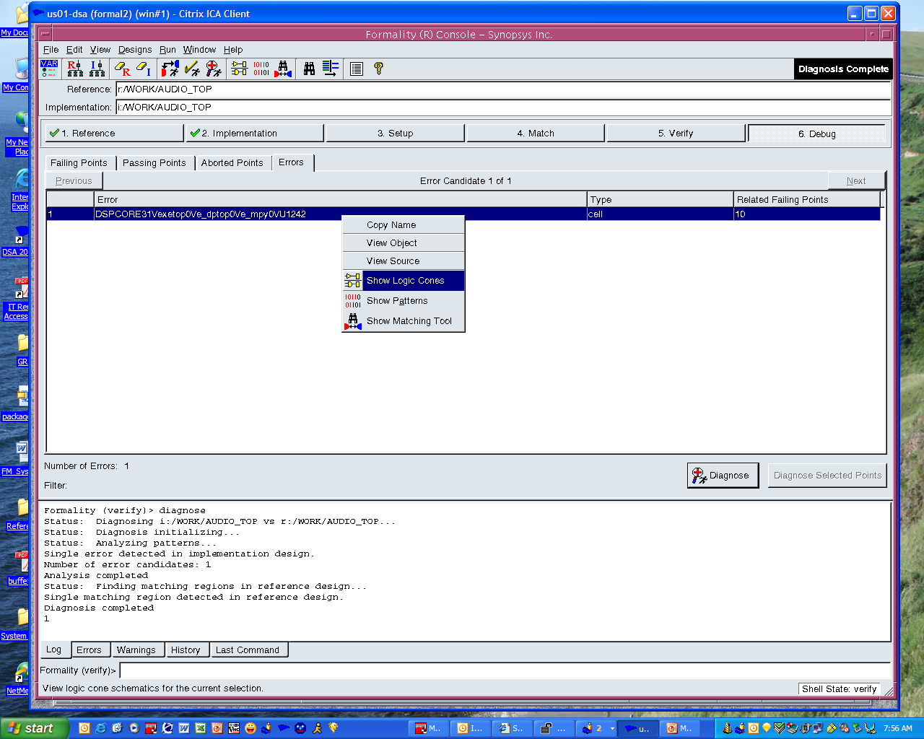
Viewing error logic cone
19

Slide 20
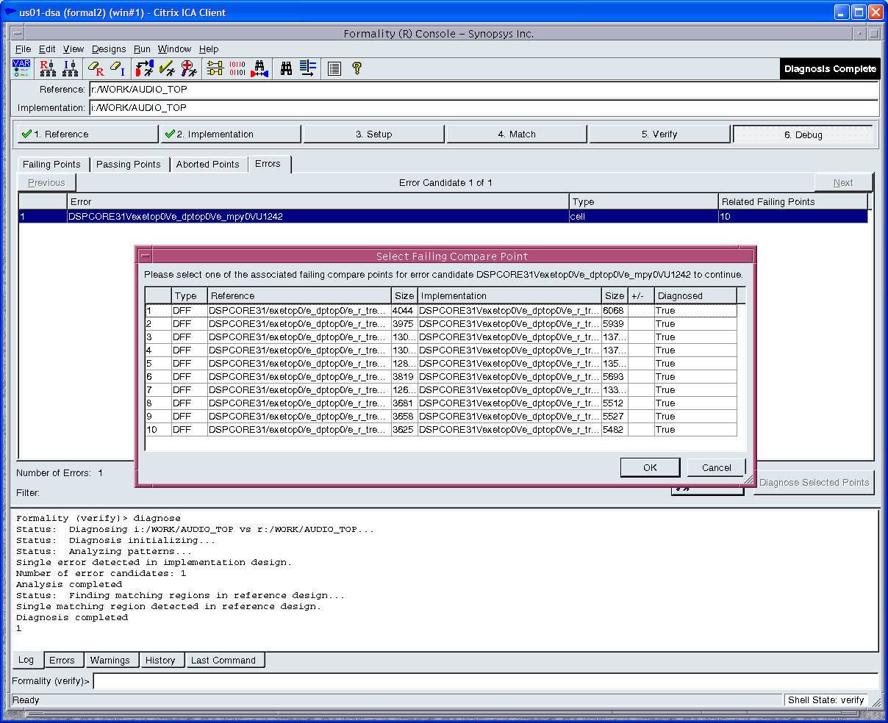
Which failing compare do you want to debug?
20

Slide 21
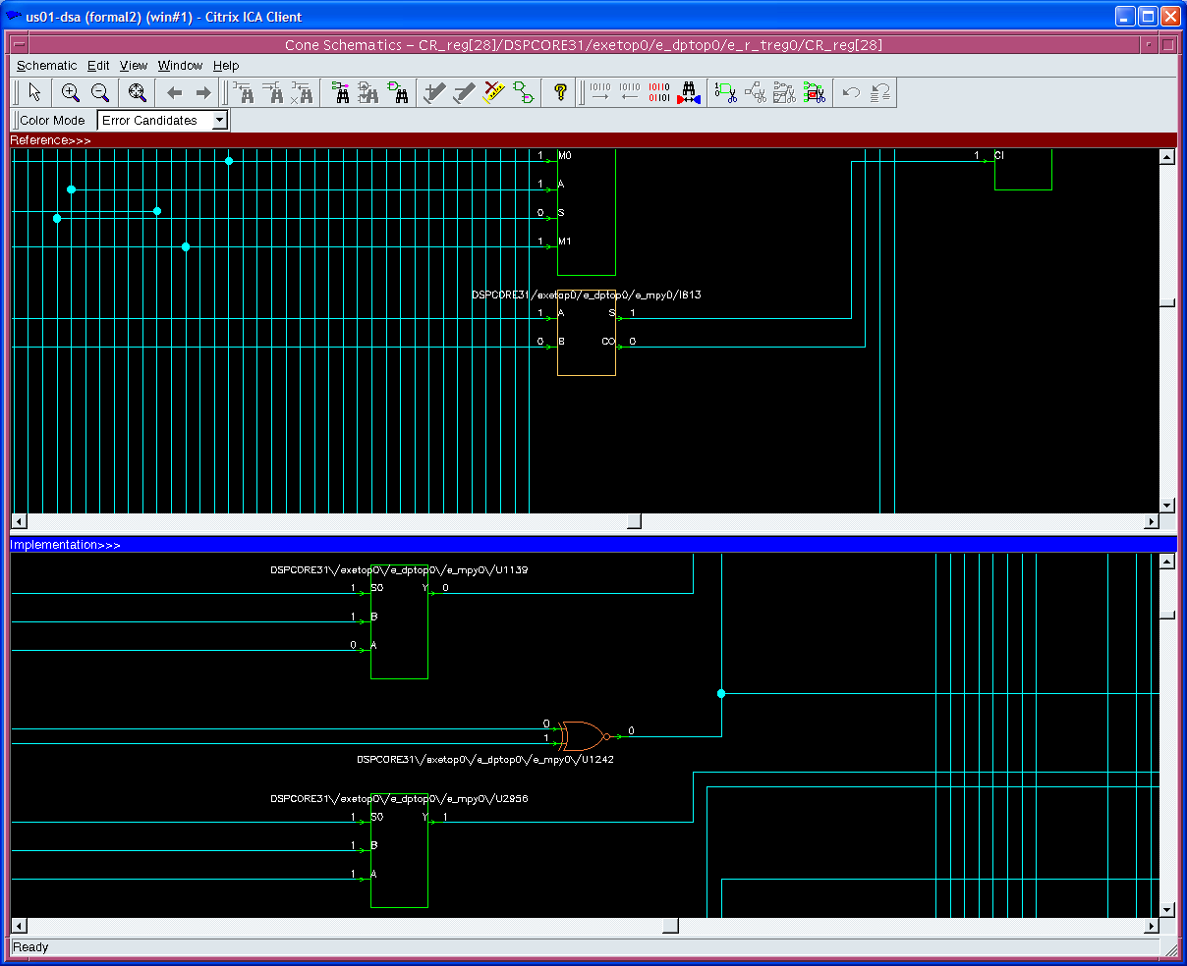
Schematic zooms to failing gate and matching region
21

Slide 22
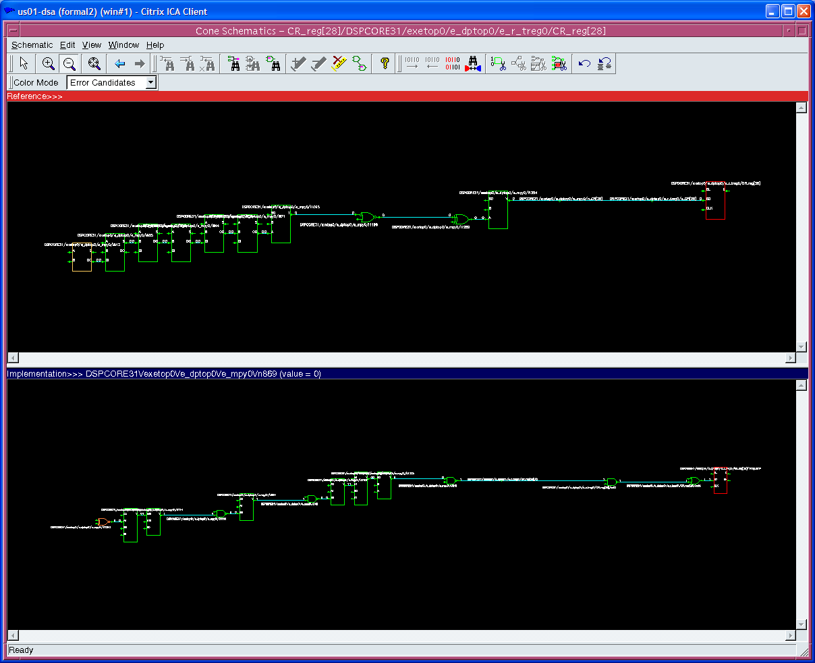
Pruning button – Shows the failing path
22

Slide 23
Diagnosing subset of failing points
Diagnosis is unable to determine an error candidate (FM-417, FM-420)
Check for setup problems
Select subset from failing points window
Select signals with common names ( ex. 32 bit bus )
Windows type selection
  Click then shift-click selects group between
  Click then ctrl-click selects individual
Click “Diagnose Selected Points” button
Final Straw: Diagnose a single point
Diagnosis accuracy drops with fewer failing points
23

Slide 24
TCL commands and variables
diagnose – Run diagnosis from the command line
report_error_candidates – Text list of error candidates
report_diagnosed_matching_regions – Text list of matching regions
diagnosis_enable_find_matching_regions – The display of matching region is on by default. Can be disabled.
diagnosis_cone_size_limit – maximum size of failing point cone
24

Slide 25
Things to watch for…
Diagnosis may not find an error. Try selected failing points
Diagnosis may not find a matching region
Logic cone sizes > 50000 are not diagnosed by default. See diagnosis_cone_size_limit
Large amount of failing points ( > 100 ) can cause performance of diagnosis to degrade. Verify with verification_failing_point_limit set to default (20)
25

Slide 26
If Error Diagnosis is unable to isolate the problem?
Pick a point to debug by inspection
  You want to debug the failing point which will show the design difference as quickly and easily as possible:
  Start with primary outputs
    You know the designs are equivalent at primary outputs and that internal points might have different logic cones due to changes like boundary optimization or inversion propagation
  Look for a point which is not part of a vector
  Pick the smallest cone to debug
27

Slide 27
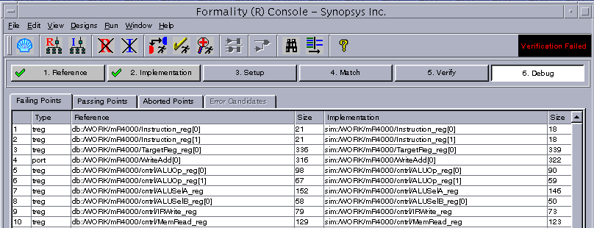
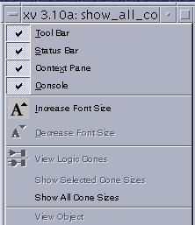
Show Cone Sizes
Show cone sizes:
28

Slide 28
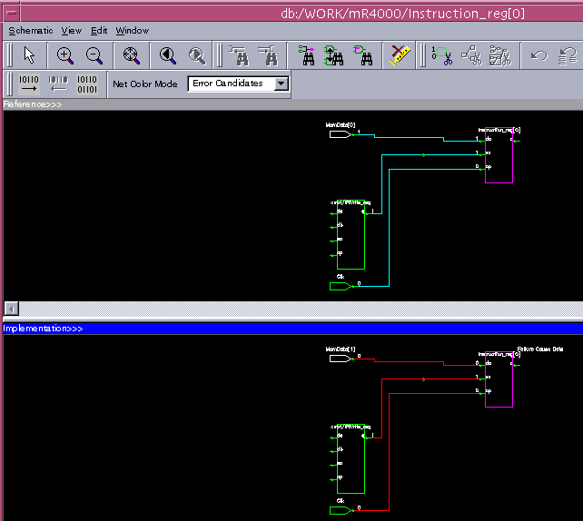
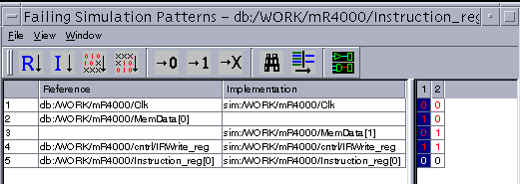
Display Pattern Window
29

Slide 29
Display Pattern Window – Look for Clues
2 Benefits of Pattern Window
2
1
30

Slide 30
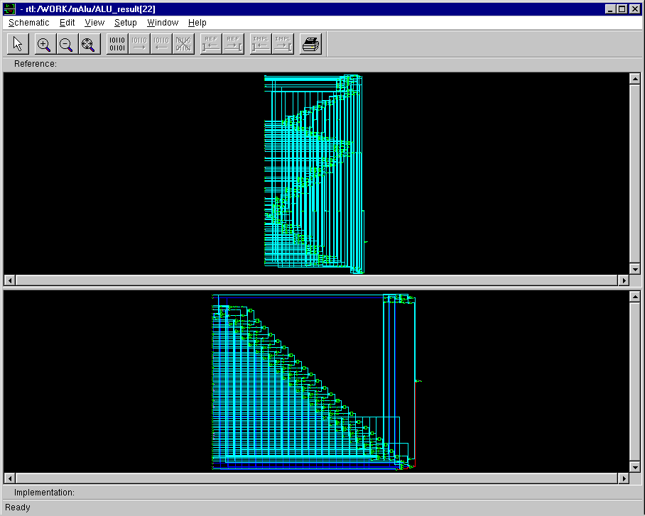
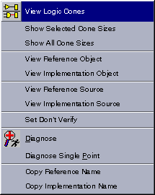
Display Logic Cone
31

Slide 31
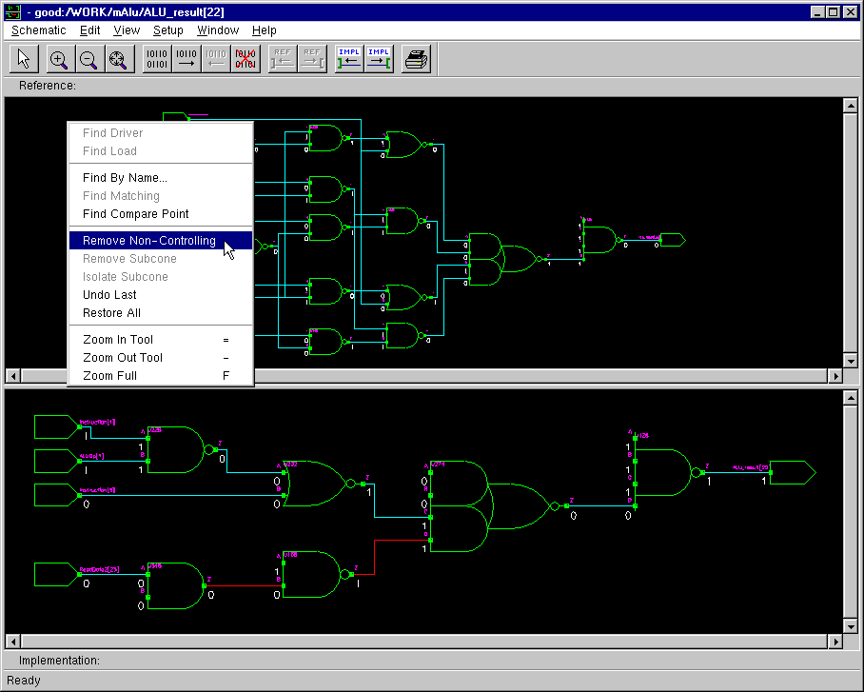
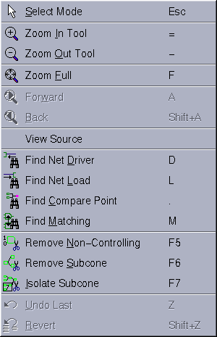
Isolate Difference
Prune logic to reduce complexity:
  Manually using Isolate/Remove Subcone
  Automatically using Remove Non-Controlling
32

Slide 32
Review Questions
How would you list the failing points from a failing verification
Which command attempts to isolate setup errors or errors in implementation for you?
What would you try if Formality reports that it is unable to determine an error candiate?
How would you select a compare point for debug by inspection?
Which Formality features would you use to help you investigate a failing point?
33

